Slide 1


PAAVAI ENGINEERING COLLEGE
(AUTONOMOUS)
DEPARTMENT OF INFORMATION TECHNOLOGY
AQUASAVE APP: EMPOWERING SUSTAINABLE
WATER USAGE THROUGH DIGITAL INNOVATION
MODEL REVIEW
BATCH NO: 3
PRESENTED by: J. ANTONY JAYANELSON(20202003)
K. DHIVYA PRIYA(20202015)
S.VIKRAM RAJA(20202060)
Final Year - IT
Paavai Engineering College.
GUIDED by:
DR.B.VENKATESAN, B.E.,M.E.,Ph.D.
Head of Department,
Department of IT,
Paavai Engineering College.

Slide 2
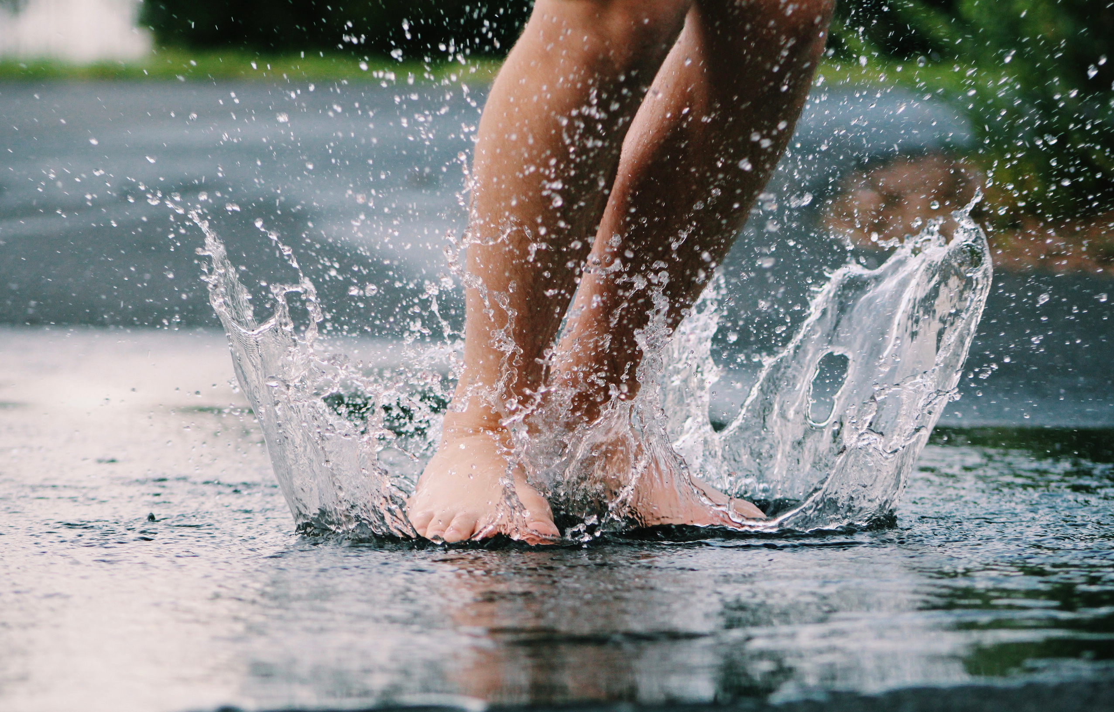
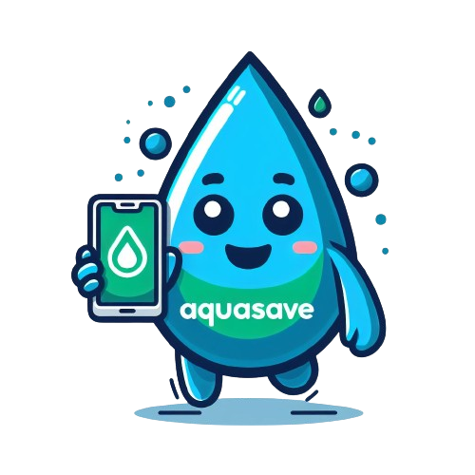


WHAT MAKES US TO THINK ABOUT IT?
WHAT WE MADE

Slide 3



Slide 4

INTRODUCTION
AquaSave App is a groundbreaking initiative aimed at revolutionizing water conservation through innovative digital solutions.
Our mobile app and website empower users to track, manage, and reduce their water footprint, fostering a sustainable and eco-conscious approach to water usage.

Slide 5

OBJECTIVES
Increase water footprint awareness.
Encourage behavioral change for water conservation.
Provide tools for users to track and manage water consumption.
Utilize real-time data for insights into water usage patterns.
Facilitate community engagement and discussions on water conservation.
Gather user feedback for continuous improvement.

Slide 6
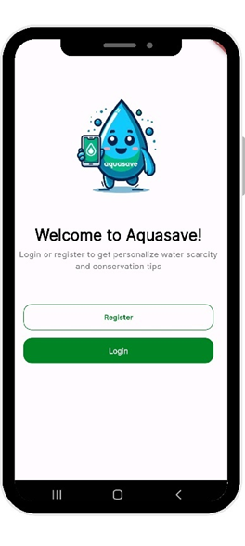
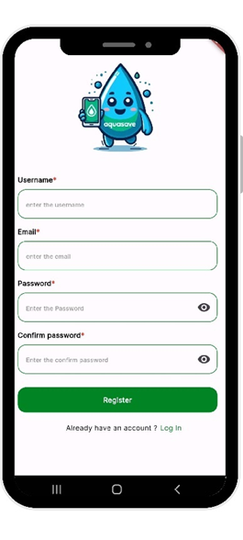
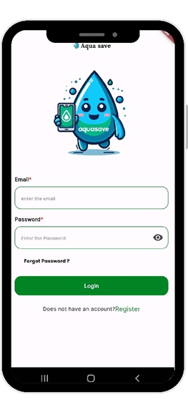

Slide 7
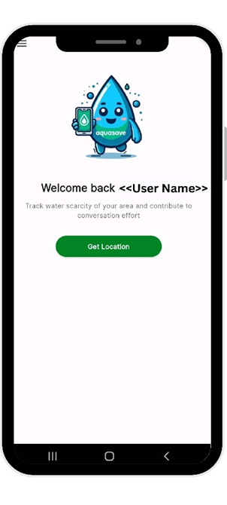
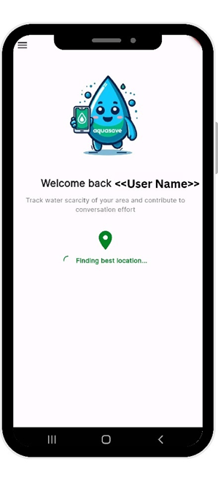
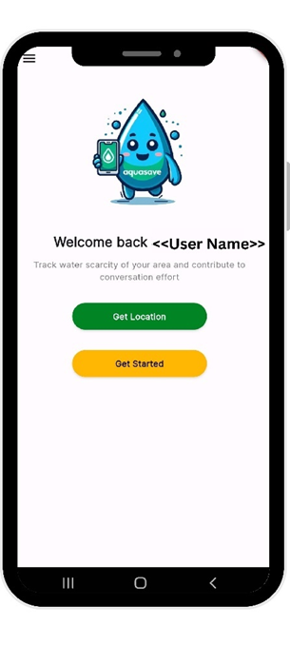

Slide 8
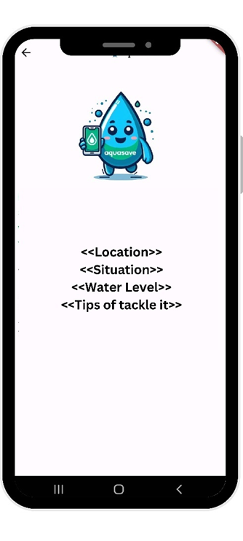
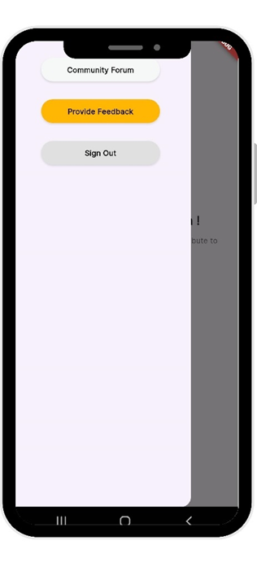
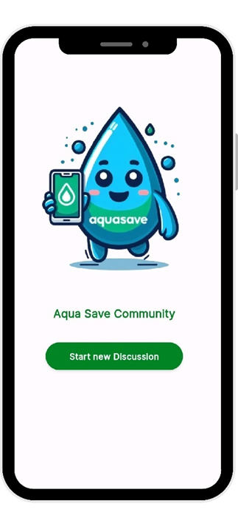

Slide 9
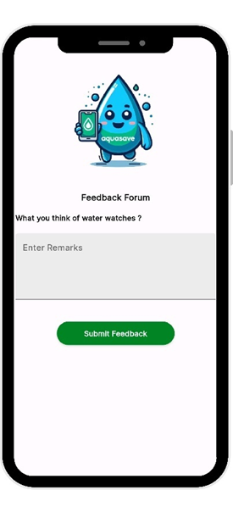
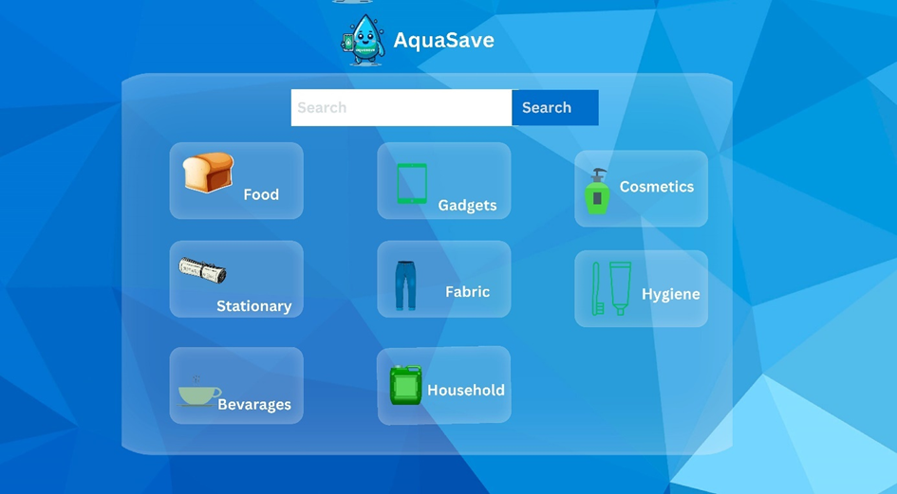

Slide 10
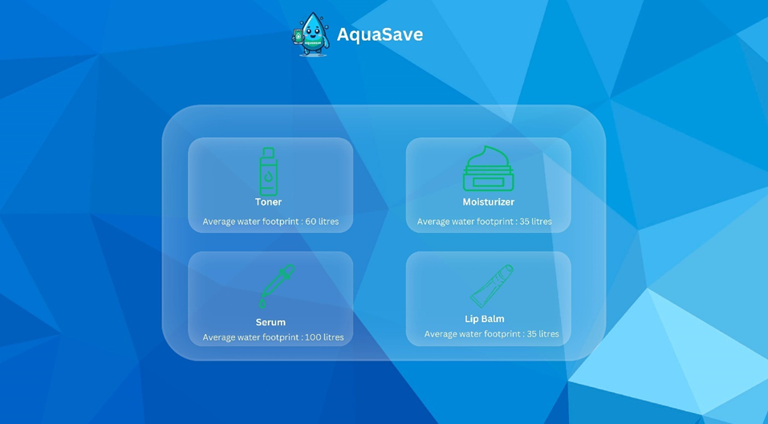

Slide 11
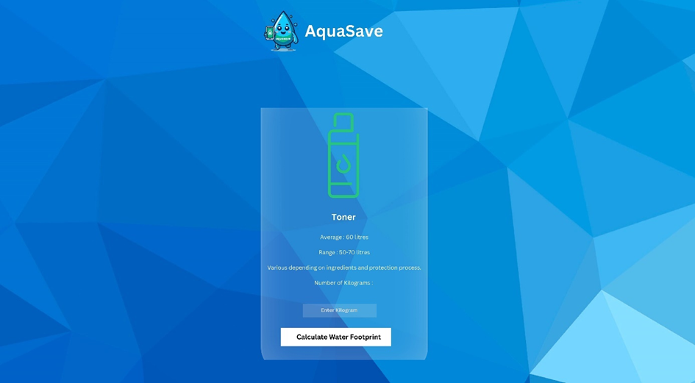

Slide 12
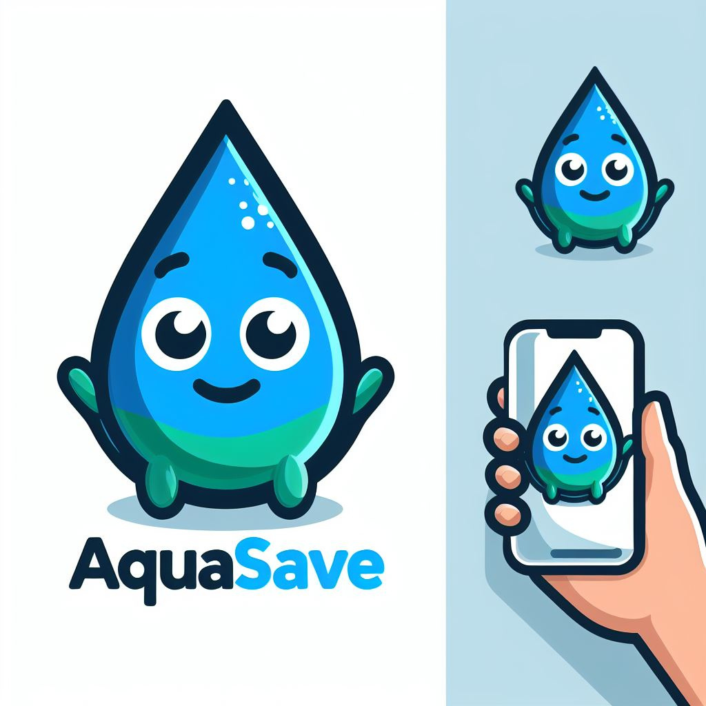
KEY FEATURES
Check Product Water Footprints
Learn About Water Conservation
Community Engagement
Get Location-Based Suggestions
Feedback and Improvement Loop

Slide 13

Water
Conservation
Community
Awareness
Educational
Tool
Data-Driven
Decision Making
Empowering
Individuals
IMPACT ON SOCIETY

Slide 14

Global Impact
Tech-Driven Solutions
Adaptable Framework
CHANGING
THE
WORLD
Inspiring Change
Environmental Stewardship

Slide 15

FUTURE ENHANCEMENTS
Track Daily Water Use
Set Water-Saving Goals
Compare Products
Localization
Integration with Smart Devices

Slide 16

CONCLUSION
AquaSave App stands as a powerful testament to the potential of digital innovation in addressing critical environmental challenges. By providing real-time data on water stress levels, promoting awareness, and empowering individuals to make sustainable choices, AquaSave contributes significantly to the global mission of water conservation.

Slide 17

SCAN ME
USE ME
THANK YOU
ANY QUERIES?

